Slide 1

Inheritance Part 3 Java - The Complete Reference Herbert Schildt Chapter 8

Slide 2
Outline
Dynamic Method Dispatch
Why Overridden Methods?
Applying Method Overriding
Using Abstract Classes
Using final with Inheritance
Using final to Prevent Overriding
Using final to Prevent Inheritance
The Object Class

Slide 3
Dynamic Method Dispatch
(Late Binding)

Slide 4
Dynamic Method Dispatch
Method overriding forms the basis for one of Java's most powerful concepts: dynamic method dispatch.
Dynamic Method Dispatch (DMD) or Late Binding is the mechanism by which a call to an overridden method is resolved at run time, rather than compile time (Early Binding).
Dynamic method dispatch is important because this is how Java implements run-time polymorphism.
An important principle in Java: A superclass reference variable can refer to a subclass object.
Java uses this fact to resolve calls to overridden methods at run time.

Slide 5
Dynamic Method Dispatch
When an overridden method is called through a superclass reference, Java determines which version of that method to execute based upon the type of the object being referred to at the time the call occurs.
Thus, this determination is made at run time.
When different types of objects are referred to, different versions of an overridden method will be called.
In other words, it is the type of the object being referred to (not the type of the reference variable) that determines which version of an overridden method will be executed.
Therefore, if a superclass contains a method that is overridden by a subclass, then when different types of objects are referred to through a superclass reference variable, different versions of the method are executed.

Slide 6
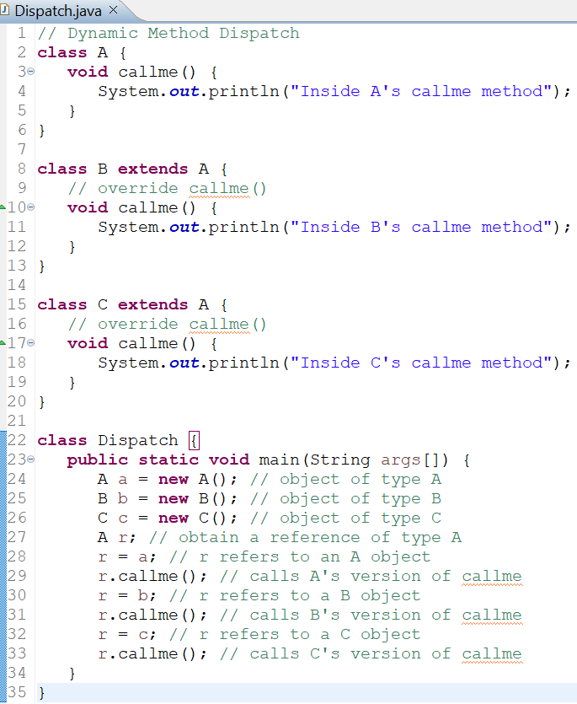
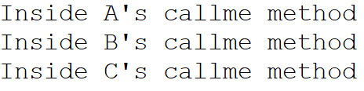
Example: Dynamic Method Dispatch
OUTPUT
NOTE: In C++ and C#, virtual functions are similar to the overridden methods in Java.

Slide 7
Why Overridden Methods?
Polymorphism is essential to object-oriented programming for one reason: it allows a general class to specify methods that will be common to all of its subclasses, while allowing subclasses to define the specific implementation of some or all of those methods.
Overridden methods are another way that Java implements the One Interface, Multiple Methods aspect of polymorphism.
Part of the key to successfully applying polymorphism is understanding that the superclasses and subclasses form a hierarchy which moves from lesser to greater specialization.
Used correctly, the superclass provides all elements that a subclass can use directly.

Slide 8
Why Overridden Methods?
It also defines those methods that the subclass must implement on its own.
This allows the subclass the flexibility to define its own methods, yet still enforces a consistent interface.
Dynamic, run-time polymorphism is one of the most powerful mechanisms that object-oriented design brings to bear on code reuse and robustness.
The ability of existing code libraries to call methods on instances of new classes without recompiling while maintaining a clean abstract interface is a profoundly powerful tool.

Slide 9
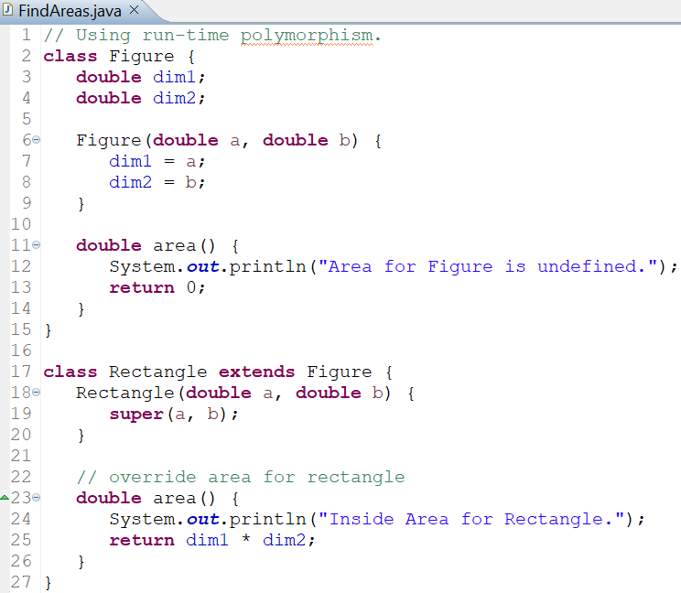
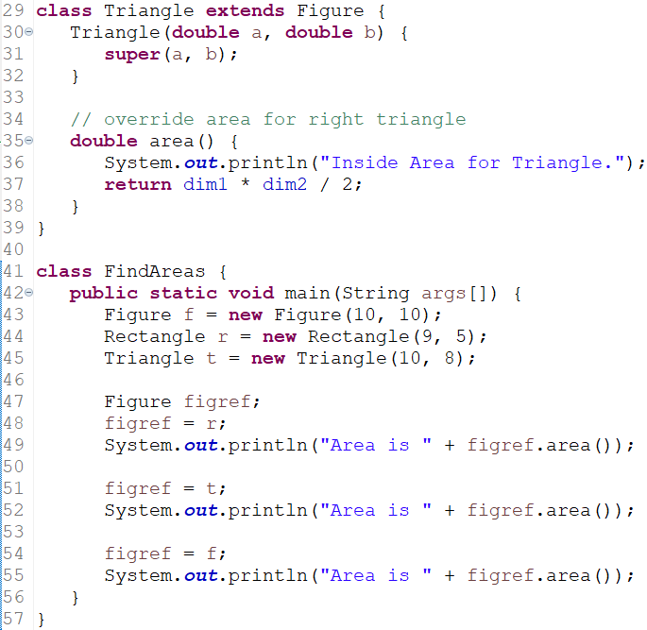
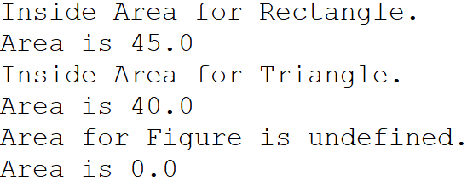
Applying Method Overriding
OUTPUT

Slide 10
Applying Method Overriding
The preceding program creates a superclass called Figure that stores the dimensions of a two-dimensional object.
It also defines a method called area() that computes the area of an object.
The program derives two subclasses from Figure.
The first is Rectangle and the second is Triangle.
Each of these subclasses overrides area() so that it returns the area of a rectangle and a triangle, respectively.
Through the dual mechanisms of inheritance and run-time polymorphism, it is possible to define one consistent interface that is used by several different, yet related, types of objects.
In this case, if an object is derived from Figure, then its area can be obtained by calling area().
The interface to this operation is the same no matter what type of figure is being used.

Slide 11
Abstract Classes

Slide 12
Abstract Classes: Introduction
There are situations in which you will want to define a superclass that declares the structure of a given abstraction without providing a complete implementation of every method.
That is, sometimes you will want to create a superclass that only defines a generalized form that will be shared by all of its subclasses, leaving it to each subclass to fill in the details.
Such a class determines the nature of the methods that the subclasses must implement.
One way this situation can occur is when a superclass is unable to create a meaningful implementation for a method (as in the case of makeSound() method in the Animal class in the following example).
Abstract classes in Java provide a solution to these types of requirements.

Slide 13
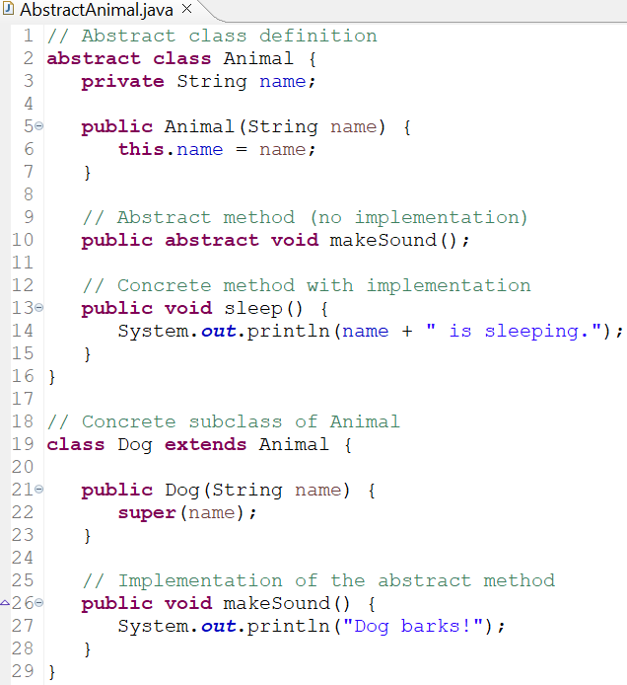
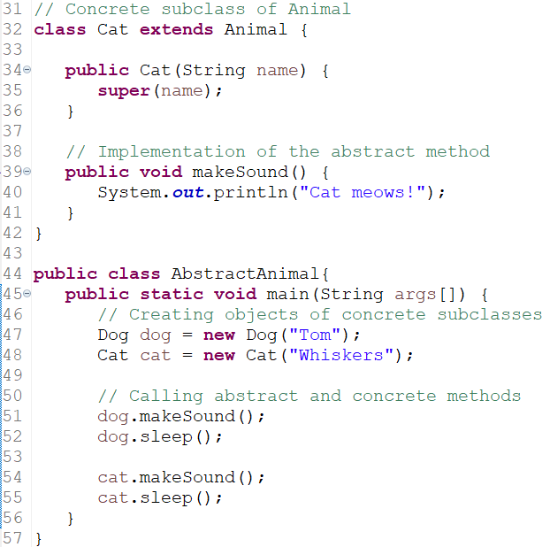
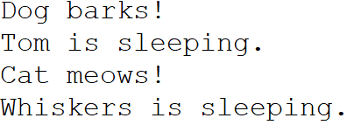
An Example of Abstract Class
OUTPUT

Slide 14

Abstract Classes: Definitions
An Abstract class in Java is a class that cannot be instantiated on its own; it serves as a blueprint for other classes (that is, its subclasses).
Abstract classes can contain Abstract methods (methods without a body) as well as Concrete methods (methods with a body).
Abstract methods defined in an abstract class must be implemented by any concrete (i.e., non-abstract) subclass that extends the abstract class.
The general form of abstract methods is:

Slide 15
Rules of Abstract Classes
Rules of Abstract Classes
Any class that contains one or more abstract methods must also be declared abstract.
There can be no objects of an abstract class.
That is, an abstract class cannot be directly instantiated with the new operator.
Such objects would be useless, because an abstract class is not fully defined.
You cannot declare abstract constructors (as constructors are related to object creation, not method overriding) or abstract static methods (as static methods are not related to inheritance and method overriding).
Any subclass of an abstract class must either implement all of the abstract methods in the superclass or be declared abstract itself.
Abstract classes can be used to create object references.
Because Java’s approach to run-time polymorphism is implemented through the use of superclass references.
Thus, it must be possible to create a reference to an abstract class so that it can be used to point to a subclass object.
The next example demonstrates this feature.

Slide 16
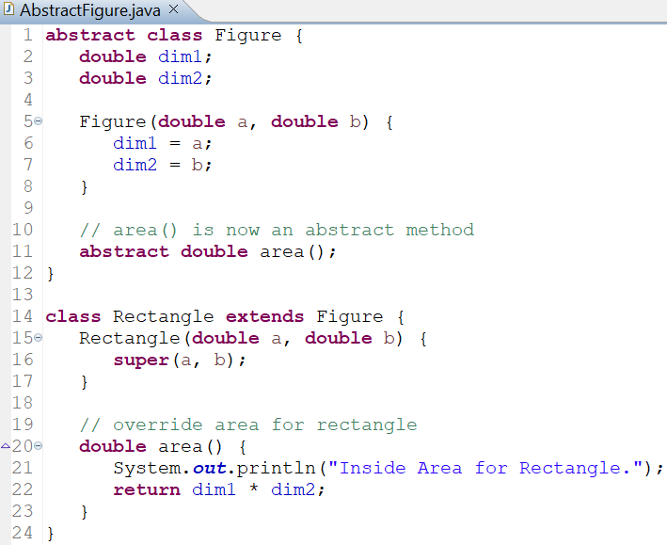
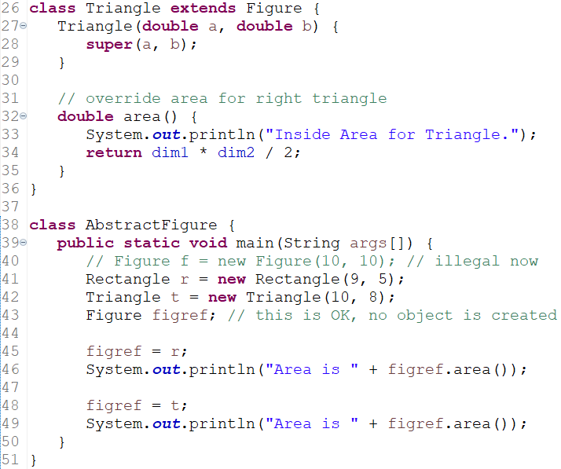
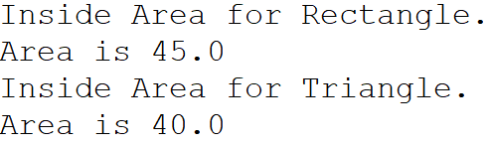
Another Example of an Abstract Class
OUTPUT

Slide 17
Explanation of Example
As the comment inside main() indicates, it is no longer possible to declare objects of type Figure, since it is now abstract.
All subclasses of Figure must override area().
To prove this, we can try creating a subclass that does not override area(). We will receive a compile-time error.
Although it is not possible to create an object of type Figure, we can create a reference variable of type Figure.
The variable figref is declared as a reference to Figure, which means that it can be used to refer to an object of any class derived (subclass) from Figure.
As explained, it is through superclass reference variables that overridden methods are resolved at run time (that is, run-time polymorphism).

Slide 18
Using final with Inheritance

Slide 19
Using final with Inheritance
The keyword final has three uses.
First, it can be used to create the equivalent of a named constant.
The other two uses of final apply to inheritance.

Slide 20
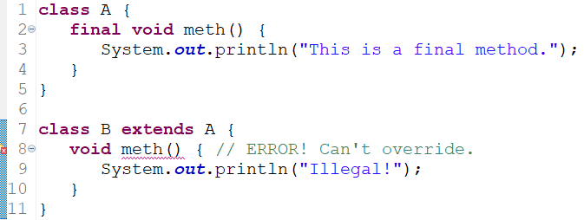
Using final to Prevent Method Overriding
There could be times when we will want to prevent method overriding from occurring.
To disallow a method from being overridden, we need to specify final as a modifier at the start of its declaration.
Methods declared as final cannot be overridden.

Slide 21
Using final to Prevent Method Overriding
Significance
Methods declared as final can sometimes provide a performance enhancement: The compiler is free to inline calls to them because it knows they will not be overridden by a subclass.
When a small final method is called, often the Java compiler can copy the bytecode for the subroutine directly inline with the compiled code of the calling method, thus eliminating the costly overhead associated with a method call.
Inlining is an option only with final methods.
Normally, Java resolves calls to methods dynamically, at run time. This is called late binding.
However, since final methods cannot be overridden, a call to one can be resolved at compile time. This is called early binding.

Slide 22
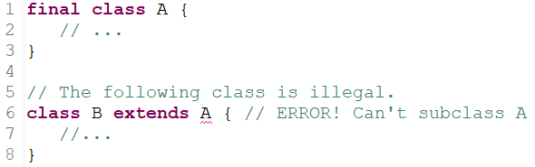
Using final to Prevent Inheritance
Sometimes we will want to prevent a class from being inherited.
To do this, we need to precede the class declaration with final.
Declaring a class as final implicitly declares all of its methods as final, too.
Therefore, it is illegal to declare a class as both abstract and final since an abstract class is incomplete by itself and relies upon its subclasses to provide complete implementations.

Slide 23
The Object Class

Slide 24
The Object Class
There is one special class, Object, defined by the Java Standard Library.
All other classes are subclasses of the Object class.
That is, the Object class is a superclass of all other classes.
This means that a reference variable of type Object can refer to an object of any other class.
Also, since arrays are implemented as classes, a variable of type Object can also refer to any array.

Slide 25
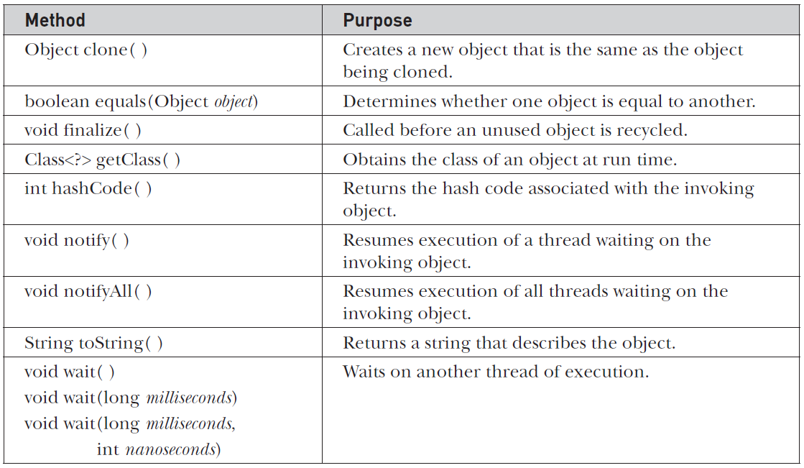
Methods Defined by Object Class
The class Object defines the following methods, which means that they are available in every object.
Java Docs: https://docs.oracle.com/javase/8/docs/api/java/lang/Object.html

Slide 26
Methods Defined by Object Class
equals()
The equals() method compares two objects.
It returns true if the objects are equal, and false otherwise.
The precise definition of equality can vary, depending on the type of objects being compared.
toString()
The toString() method returns a string that contains a description of the object on which it is called.
Also, this method is automatically called when an object is output using println().
Many classes override this method.
Doing so allows them to tailor a description specifically for the types of objects that they create.

Slide 27
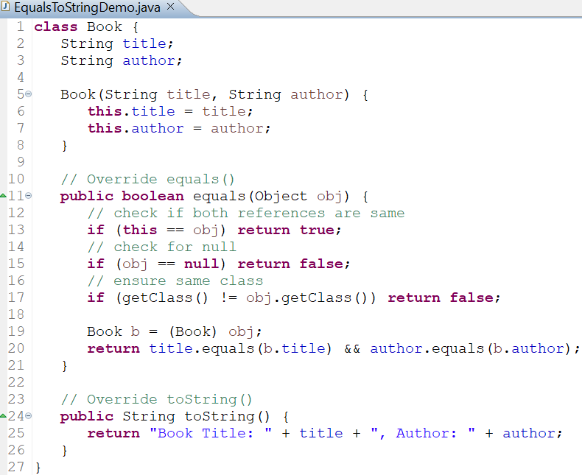
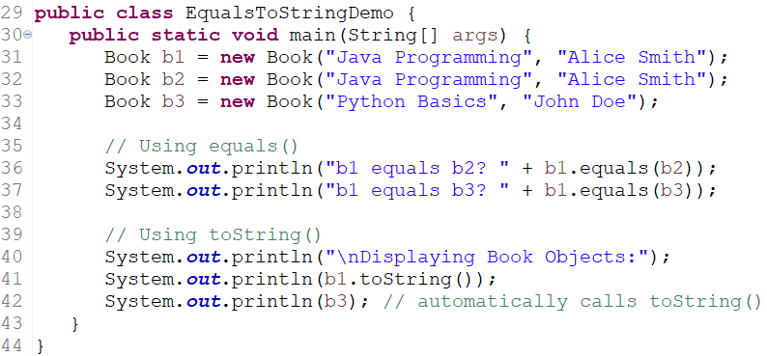
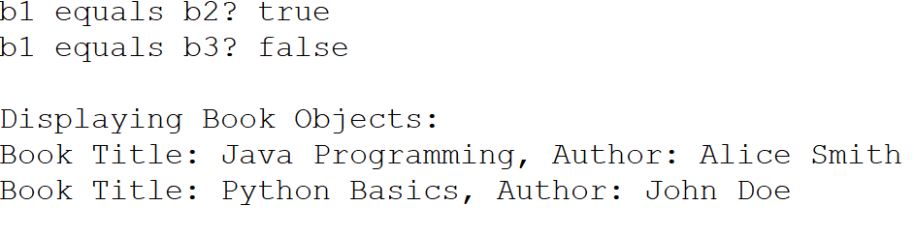
Example: equals() and toString()
OUTPUT

